Slide 1
2014 Brazilian Dietary Guidelines
Health, well-being and sustainability in the same plate
Dietary Guidelines Symposium
The George Washington University and Tufts University
Washington DC, November 14, 2014
Carlos A. Monteiro
carlosam@usp.br
Center for Epidemiological Studies in Health and Nutrition
University of Sao Paulo, Brazil

Slide 2
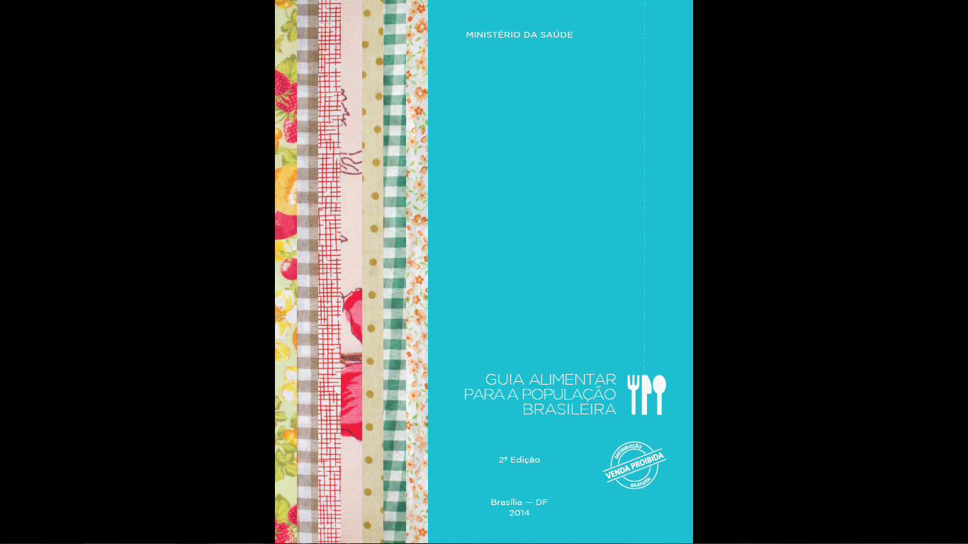

Slide 3
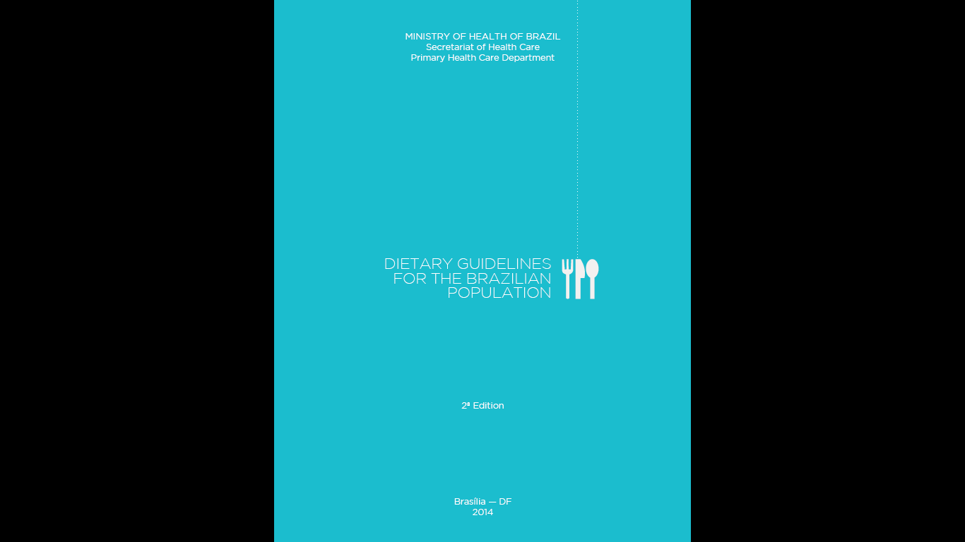
http://nupensusp.wix.com/nupens#!__englishttp://nuhttp://nupensusp.wix.com/nupens#!__english/new-brazilian-dietary-guidelinespensusp.wix.com/nupens#!__english/newhttp://nupensusp.wix.com/nupens#!__english/new-brazilian-dietary-guidelineshttp://nupensusp.wix.com/nupens#!__english/new-brazilian-dietary-guidelinhttp://nupensusp.wix.com/nupens#!__english/new-brazilian-dietary-guidelineseshttp://nupensusp.wix.com/nupens#!__english/new-brazilian-dietary-guidelineshttp://nupensusp.wix.com/nupens#!__english/new-brazilian-dietary-guidelines-brazilian-dietary-guidelinesh/new-brazilian-dietary-guidelines
Download the English version at:
nupensusp.wix.com/nupensnupens#!__english/new-brazilian-dietary-guidelines

Slide 4
2014 Brazilian Dietary Guidelines
Chapter 1 Principles
Chapter 2 Choosing foods
Chapter 3 From foods to meals
Chapter 4 Mindful eating and commensality
Chapter 5 Overcoming obstacles
Further reading

Slide 5
Chapter 1. Principles
Diet is more than the intake of nutrients
Healthy diets derive from socially and environmentally sustainable food systems
Dietary recommendations need to be tuned to their times
Different sources of knowledge inform sound dietary advice
Dietary guidelines broaden autonomy in food choices

Slide 6
Chapter 1. Principles
Diet is more than the intake of nutrients

Slide 7
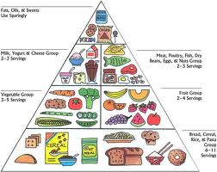
Diet reduced to the nutrients contained in the foods eaten during the day
Sodium,
Sucrose,
Fatty acids
Proteins
Vitamins
Minerals
Carbohydrates

Slide 8
Diet reduced to the nutrients contained in the foods eaten during the day
Sodium,
Sucrose,
Fatty acids
Proteins
Vitamins
Minerals
Carbohydrates

Slide 9
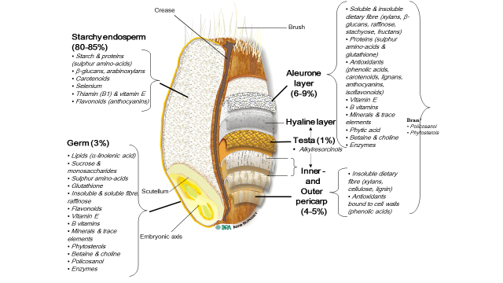
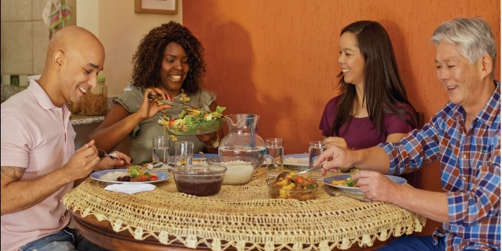
Diet as including:
foods
meals
and eating patterns
See: Jacobs & Tapsell 2013. Food synergy: the key to a healthy diet. Proc Nutr Soc 72, 2, 200-206, Scrinis. Nutritionism. NY, Columbia University Press 2013 and Cohen & Farley 2008. Eating as an automatic behavior. Prev Chronic Dis 5:1-7

Slide 10
Chapter 1. Principles
Diet is more than the intake of nutrients
Healthy diets derive from socially and environmentally sustainable food systems

Slide 11
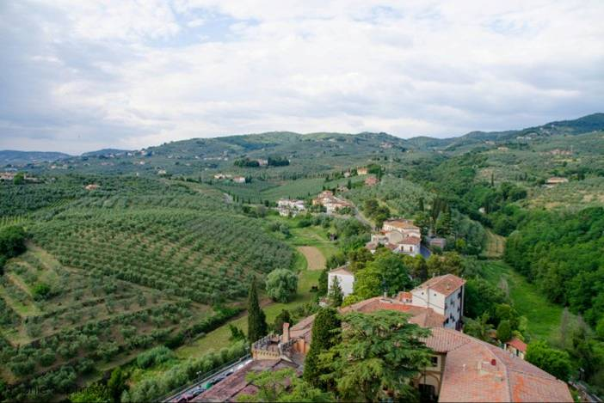
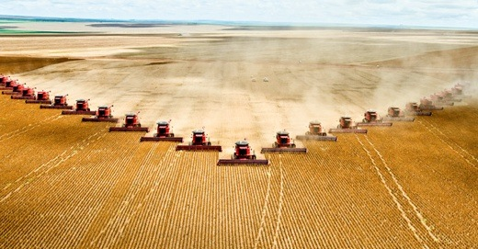
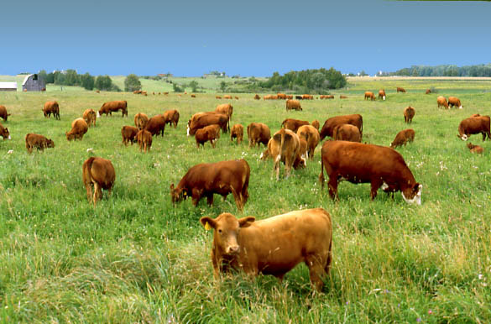
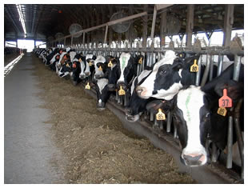
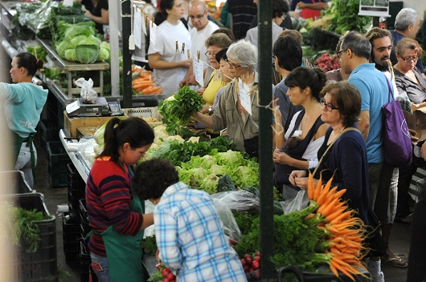
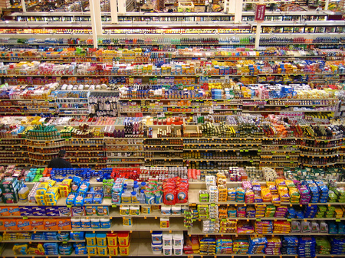
  Sustainable food systems promote social justice and protect natural resources and biodiversity
Size and use of farms
Secure and settled local communities
Working conditions
Stages between farmers and consumers
Fairness of the trading system
Generation of jobs
Income distribution
Use of water and non-renewable energy
Techniques for soil conservation
Organic or synthetic fertilisers
Conventional or transgenic seeds
Biological or chemical control of plagues
Extensive or intensive rearing of animals
Husbandry of forests, landscape, wildlife
Intensity and nature of food processing
See: FAO Sustainable diets and biodiversity. Rome 2010 and Lang, Barling and Caraher. Food Policy . Integrating Health, Environment and Society. Oxford University Press, 2009

Slide 12
Chapter 1. Principles
Diet is more than the intake of nutrients
Healthy diets derive from socially and environmentally sustainable food systems
Dietary recommendations need to be tuned to their times
Different sources of knowledge inform sound dietary advice
Dietary guidelines broaden autonomy in food choices

Slide 13

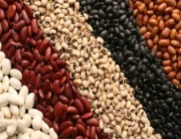

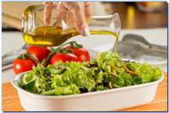
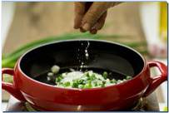





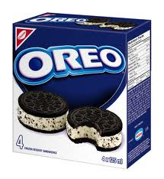




Chapter 2. Choosing foods
Food groups | Examples
Unprocessed or minimally processed foods
Processed food substances for culinary use
Processed foods
Ultra-processed food and drink products
See: Moubarac, Parra , Cannon, Monteiro. Food classification systems based on food processing. Curr Obes Rep 2014 3: 256-273

Slide 14






Chapter 2. Choosing foods
1. Make a variety of minimally processed plant foods the basis of your diet
Unprocessed or minimally processed foods, in great variety, mainly of plant origin, and, whenever possible, produced by agro-ecologic family farmers are the basis for diets that are nutritious, delicious, culturally appropriate, and
supportive of socially and environmentally sustainable food systems

Slide 15
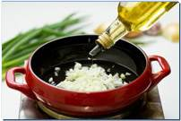
Chapter 2. Choosing foods
2. Use oils, fats, salt, and sugar in small amounts for seasoning and cooking minimally processed foods
and to create culinary preparations
As long as they are used in moderation, oils, fats, salt, and sugar contribute to diverse and delicious diets without making them nutritionally unbalanced

Slide 16
Chapter 2. Choosing foods
Limit processed foods to small amounts as part of freshly-prepared dishes and meals
The ingredients and techniques used in the manufacture of processed foods alter
unfavorably the nutritional composition of the foods from which they are derived
To limit:
Processed products

Slide 17


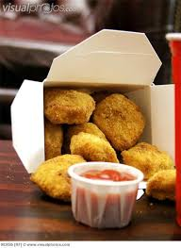
Chapter 2. Choosing foods
4. Avoid ultra-processed food and drink products
Because of their ingredients, ultra-processed products are nutritionally unbalanced. As a result of their formulation and presentation, they tend to be consumed in excess, and to displace real foods. Their means of production, distribution, marketing, and consumption damage culture, social life, and the environment.
To avoid:
Ultra-processed products

Slide 18
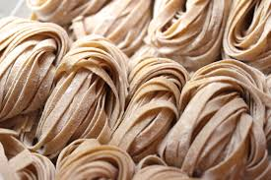
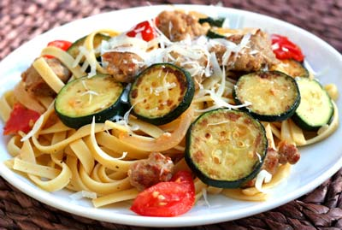
Food processing is overall beneficial when its purpose is to preserve foods and to enable handmade preparation of diverse and delicious meals
Minimally processed foods
Processed food substances for culinary use
Processed foods
MULTI-FOOD FRESHLY PREPARED MEALS
(mostly consumed in regular times, at table, and often in company)

Slide 19
Chapter 2. Choosing foods
1. Make a variety of minimally processed plant foods the basis of your diet
2. Use oils, fats, sugar and salt in moderation for seasoning and cooking minimally processed foods and to create culinary preparations
3. Limit processed foods to small amounts as part of freshly prepared dishes and meals
4. Avoid ultra-processed food and drink products
The golden rule
Always prefer a variety of minimally processed foods and freshly prepared dishes and meals to ultra-processed products

Slide 20

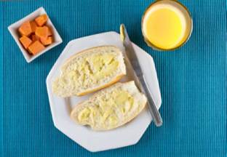
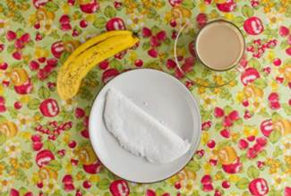
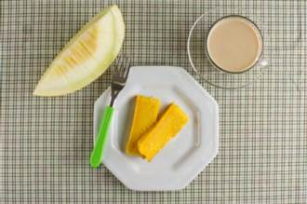
Chapter 3. From foods to meals
Examples of meals taken from Brazilians who base their diet
on minimally processed foods and freshly prepared dishes
Breakfast
Milk, couscous, egg, banana
Man, 20, North-East region
Orange juice, roll, butter, papaya Woman, 44, South region
Coffee with milk, tapioca, banana
Woman, 58, North region
Coffee with milk, corn cake, melon
Woman, 34, Mid-West region

Slide 21
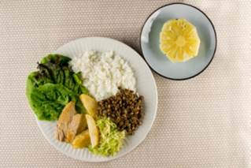
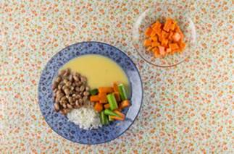
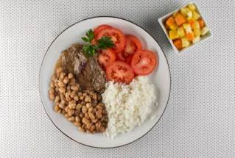
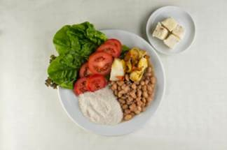
Chapter 3. From foods to meals
Examples of meals taken from Brazilians who base their diet
on minimally processed foods and freshly prepared dishes
Lunch
Lettuce, rice, lentils, roast pork, potatoes, sautéed cabbage, pineapple
Man, 43, South region
Rice, beans, corn mash, squash, okra, papaya
Woman, 49, South region
Tomatoes, rice, beans, beef, fruit salad Man, 50, Mid-West region
Lettuce, tomato, beans, manioc grits, stewed fish, coconut
Man, 28, North-East region

Slide 22
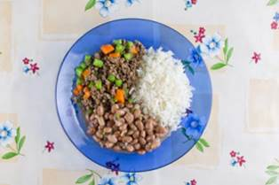
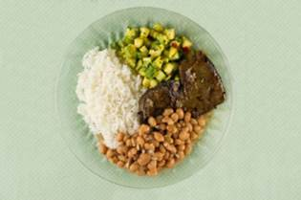
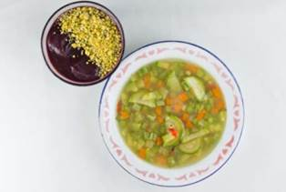
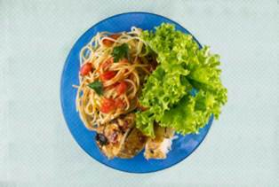
Dinner
Chapter 3. From foods to meals
Examples of meals taken from Brazilians who base their diet
on minimally processed foods and freshly prepared dishes
Rice, beans, ground beef, vegetables
Woman, 28, Mid-West region
Rice, beans, beef liver, zucchini
Man, 33, South-East region
Vegetable soup, açaí, cassava grits
Man, 15, North region
Salad, pasta, chicken
Man, 45, South region

Slide 23
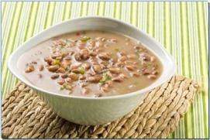
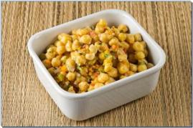
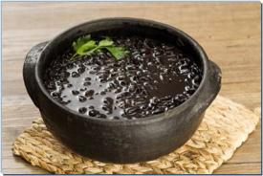
How to increase variety
Principal food groups in the Brazilian diet,
varieties within groups, and culinary uses
Beans and other pulses
Carioca beans
Chickpea salad
Black beans

Slide 24
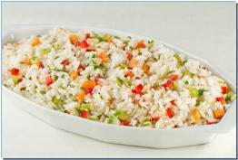
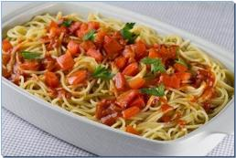
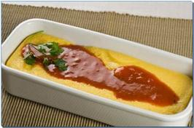
How to increase variety
Principal food groups in the Brazilian diet,
varieties within groups, and culinary uses
Cereals
Rice with vegetables
Pasta with tomato and herbs
Polenta with tomato sauce

Slide 25
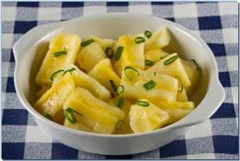
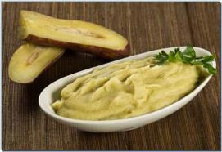
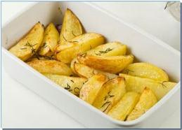
How to increase variety
Principal food groups in the Brazilian diet,
varieties within groups, and culinary uses
Roots and tubers
Manioc with green onions
Mashed sweet potatoes
Baked potatoes with herbs

Slide 26
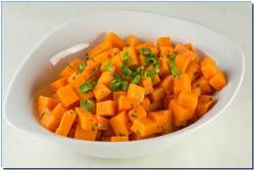
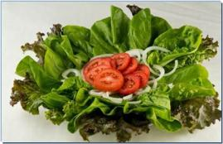
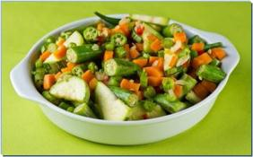
How to increase variety
Principal food groups in the Brazilian diet,
varieties within groups, and culinary uses
Vegetables
Squash. onion, herbs
Lettuce salad, tomato, onion
Various sautéed vegetables

Slide 27
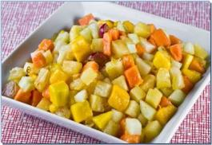
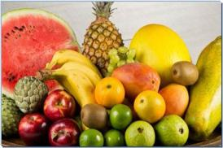
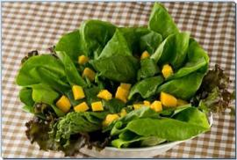
How to increase variety
Principal food groups in the Brazilian diet,
varieties within groups, and culinary uses
Fruits
Fruit salad
Variety of fruits
Mango in salad

Slide 28
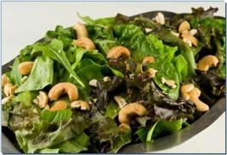
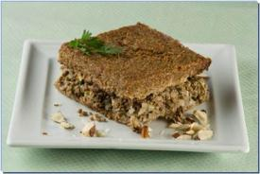
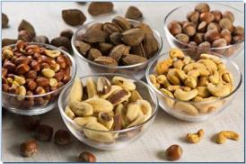
How to increase variety
Principal food groups in the Brazilian diet,
varieties within groups, and culinary uses
Nuts
Salad with cashews
Kebab roasted with nuts
Varied nuts

Slide 29
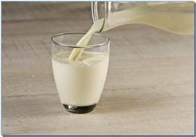
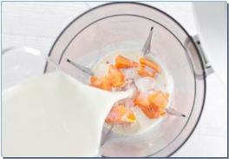

How to increase variety
Principal food groups in the Brazilian diet,
varieties within groups, and culinary uses
Milk
Milk
Papaya with milk
Yoghurt with fresh fruit

Slide 30



How to increase variety
Principal food groups in the Brazilian diet,
varieties within groups, and culinary uses
Meat, poultry, fish, seafood, eggs
Grilled fish with potatoes
Beef, potatoes, vegetables
Omelette, herbs, vegetables

Slide 31



And to drink every day...
Water
From the tap
Filtered
With lime
No bottled water, please!

Slide 32



Foods and freshly-prepared dishes contain a lot of water
Most ultra-processed products don’t!

Slide 33
Chapter 4. Mindful eating and commensality
Eat regularly and mindfully
Schedule daily meals at regular times. Focus on your food, enjoy it, eat slowly and thoughtfully, and avoid being distracted. Avoid eating between meals
Eat in pleasant surroundings
Make the room where you eat at home special, pleasant, quiet and attractive. Avoid noise and stress and places where you are liable to over-eat
Eat in company
Prefer eating with family, friends or colleagues, at home, at work, when eating out. Share in acquiring, preparing and cooking meals, and clearing up afterwards

Slide 34
Chapter 5. Overcoming obstacles
(or swimming against the tide)
Supply and cost of minimally processed foods
Lack of culinary skills
Lack of time
Aggressive marketing of ultra-processed products

Slide 35
Make a variety of fresh or minimally processed plant foods the basis of your diet
Use oils, fats, sugar and salt in moderation to cook foods and prepare meals
Limit processed foods to small amounts and as part of freshly-prepared meals
Avoid ultra-processed products
Eat freshly cooked meals regularly, mindfully, in pleasant places, and in company
6 Buy food in places that offer a variety of fresh, locally produced foods
Learn, value, practice and share the art of cooking
Give the pleasure of eating a central place in your life
Choose places to eat out that serve freshly cooked meals
10 Beware of information and orientation from sources with conflicted interests
Ten steps to healthy diets

Slide 36










Further reading

Slide 37

2014 Brazilian Dietary Guidelines
Second national workshop with researchers, MoH officers, health professionals and NGO representatives
Apoio

Slide 38

THE FOOD
SYSTEM
The big issue for nutrition
Carlos Monteiro, Geoffrey Cannon
Renata Bertazzi Levy, Rafael Claro, Jean-Claude Moubarac
Ana Paula Martins, Maria Laura Louzada, Larissa Baraldi, Daniela Canella,
Diana Parra, Logan Mauney, Maluh Barciottte, Semiramis Domene
Centre for Epidemiological Studies in Health and Nutrition (NUPENS)
School of Public Health, University of Säo Paulo, Brazil

